Slide 1

SYRIA
TEL
DATA ANALYSIS PROJECT
GROUP 8

Slide 2

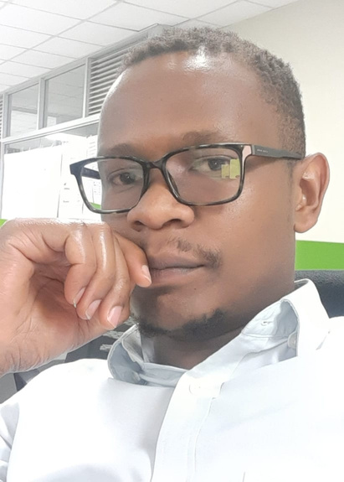
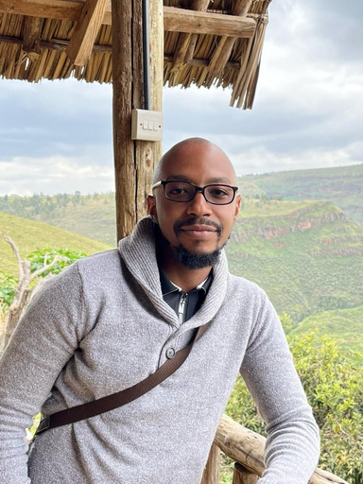

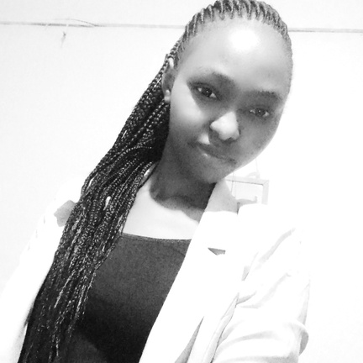
Sydney Mumbo
James Ndiritu
Brian Kanyotu
Our Team Members
Chair
Nicholas Njubi
Chepkemoi Mercy
GROUP 8

Slide 3
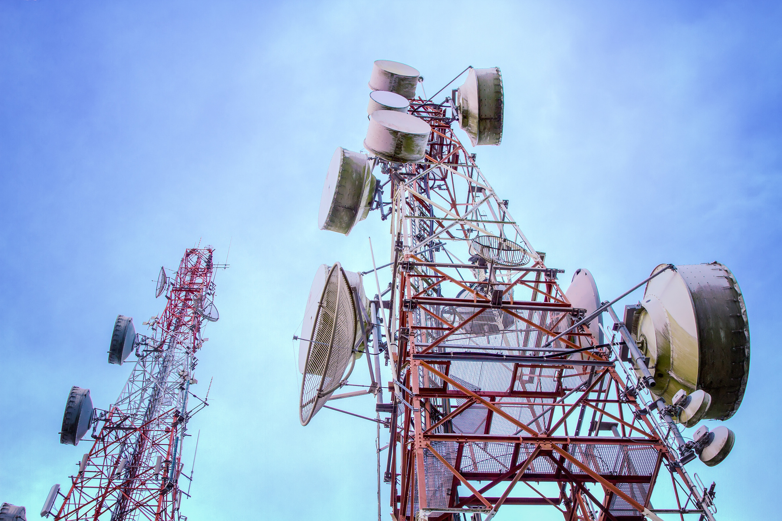
PROJECT SUMMARY
We propose building a robust classifier to predict customer churn for SyriaTel. Leveraging predictive analytics and advanced machine learning, we aim to identify potential churners and minimize revenue loss. Our goal is to empower SyriaTel with actionable insights for proactive retention strategies, ensuring long-term business sustainability.
CLICK HERE

Slide 4


OUTLINE
1) Business Problem
2) Data
3) Methods
4) Results
As a source of social and cultural status
Livestock products include meat, milk, eggs, and clothing (such as wool).

Slide 5

PROJECT
GOAL
Customer churn poses a significant challenge for companies, directly impacting revenue. In the competitive telecommunications industry, like SyriaTel, churn is prevalent. We aim to create predictive models to anticipate and prevent churn, supporting SyriaTel's retention strategies.

Slide 6

DATA
Our data, sourced from Syriatel Telecommunications (Downloaded from Kaggle website) includes comprehensive customer service records, encompassing various customer details and usage metrics such as calls, charges, and churn status.
CLICK HERE

Slide 7

METHOD
1) Data Loading and understanding
2) Data Preparation
3) Distribution of data
4) Data Pre-processing
5) Model development and evaluaion
6) Model Optimization

Slide 8

RESULTS
Our analysis identified the following key factors impacting customer churn:
Total Day Minutes: Usage during daytime.
Total International Minutes: Usage of international minutes.
Total Day Charge: Billed cost for daytime calls.
Total Evening Charge: Billed cost for evening calls.
Customer Service Calls: Number of calls to Customer Service.
International Calls: Total international call count.
Total Charge: Sum of Day, Evening, Night, and International charges.

Slide 9

RESULTS
Syriatel's data analysis showed Random Forest Classifier excels, offering superior accuracy for classification tasks.
Think of it as a reliable team providing insights for confident business decisions, like predicting customer churn.

Slide 10
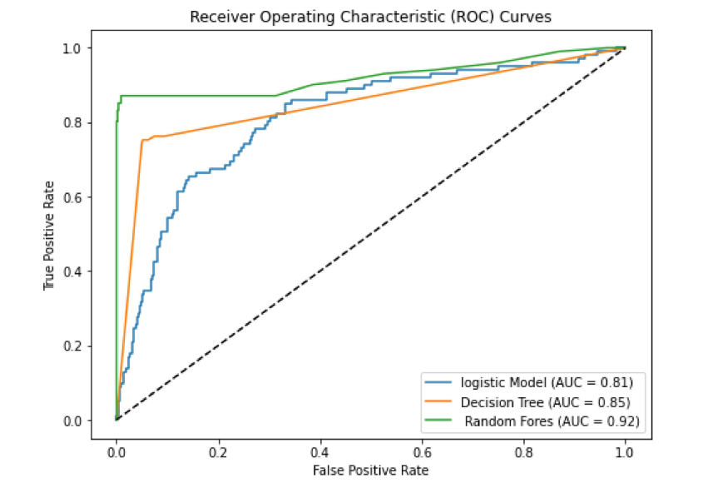
Why
Random
Forest?
After our investigation, we chose Random Forest as the best option, thanks to its top AUC score, meeting our needs effectively.

Slide 11

Recommendations
Introduce discounts and offers to reduce churn rates and incentivize customer loyalty.
Lower call charges to improve customer satisfaction and retention.
Refine service agent training programs for faster and better assistance.
Improve network coverage and service quality to minimize customer service calls and enhance customer experience.

Slide 12
THANK
YOU
TILL NEXT TIME!

